Slide 1
Product Knowledge Training Session PIBAS Products – TRANSACTION MODULE
Presented By PIBAS Support Team

Slide 2
Transactions
Contents
General Transactions
Forex Retail Deal Transactions
Transaction Cancellation
Supervision by Transaction
Supervision / Cancellation of Forex Retail Deal Transactions
Transaction Review
Transaction List Batch-wise
Transaction List Account-wise

Slide 3
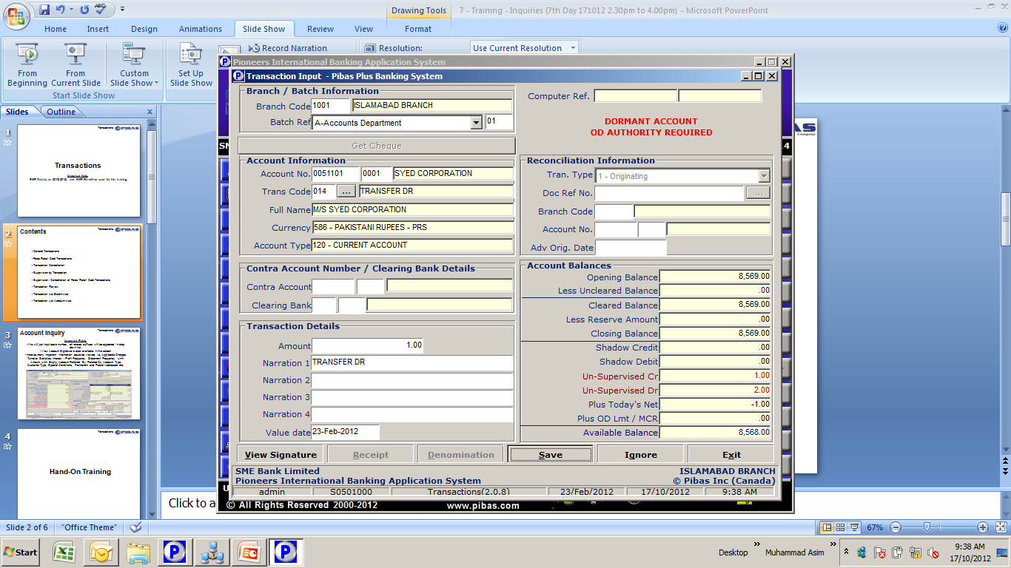
Transactions
General Transactions
Important Points
Here you can execute different type of transactions i.e. Cash, Inward Clearing, Transfers, Reversals, Commission Recoveries, Expenses etc. through available list of transaction codes. Usually through different transaction codes you will have to debit and then credit separately but some particularly transactions codes are also available through which you can post your entries (debit and credit) in one attempt i.e. Transaction Code 017 wherein you can debit on account and credit the other one in one go.
Every transaction will be supervised, if user has transaction limit so supervision will not be required.

Slide 4
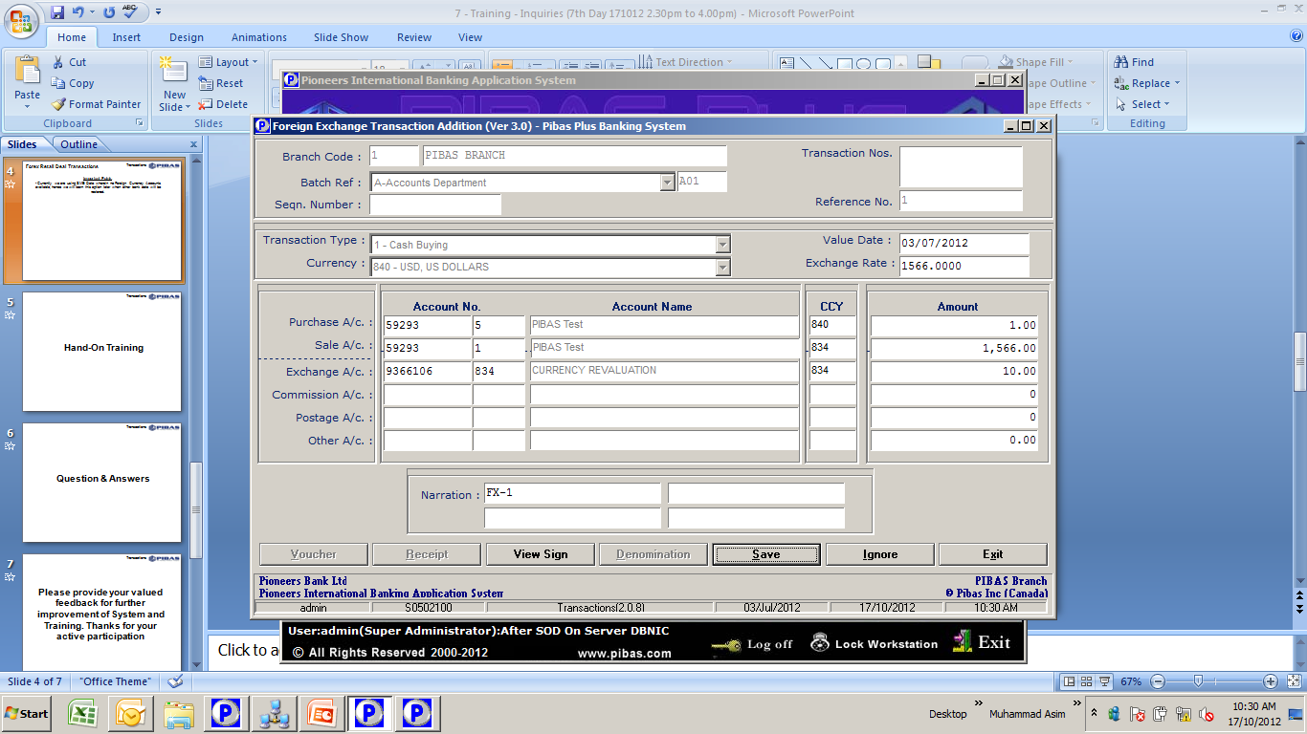
Transactions
Forex Retail Deal Transactions
Important Points
We will use this option to transact between two different type of currencies whether Selling or Buying and Cash or Transfer
In these type of transactions exchange loss / profit will be booked in case of different exchange rate.
Currently we are using SME Bank Data wherein no Foreign Currency Accounts available so first we will load some other bank data to practice.

Slide 5
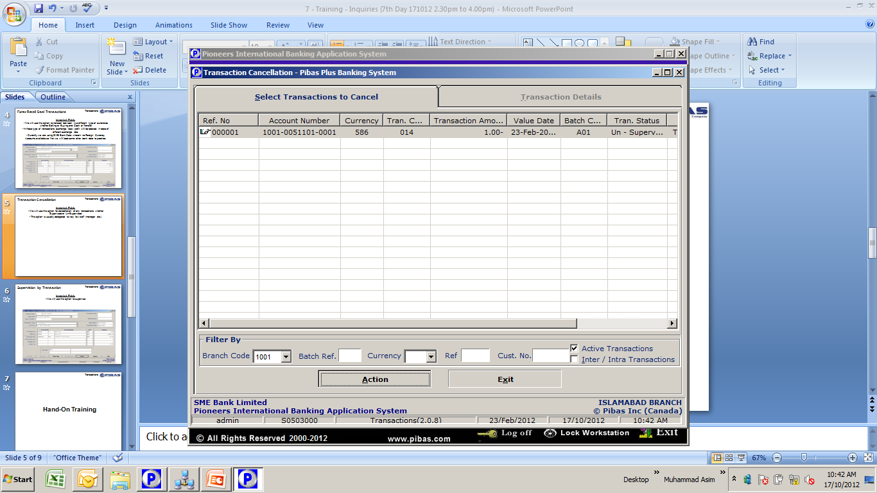
Transactions
Transaction Cancellation
Important Points
We will use this option for cancellation of any transactions whether Supervised or Un-Supervised
This option is usually delegated to very few staff (manager etc.)

Slide 6
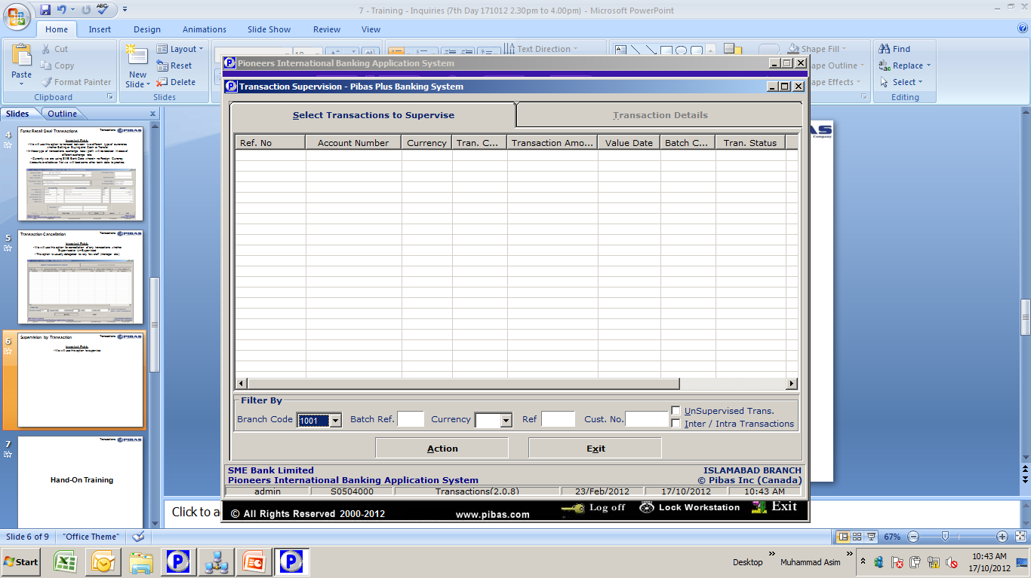
Transactions
Supervision by Transaction
Important Points
We will use this option to supervise any transaction
This option will update balance of an account

Slide 7
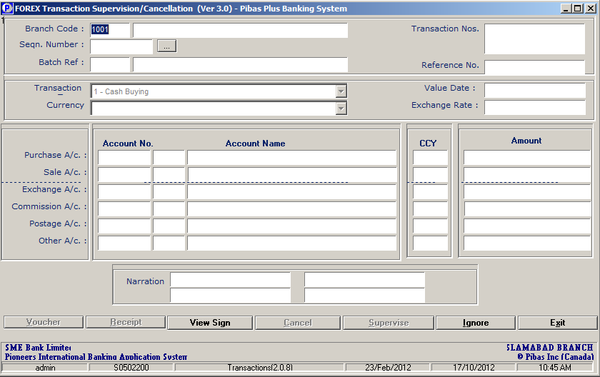
Transactions
Supervision / Cancellation of Forex….
Important Points
We will use this option to supervise / cancel any Forex Transaction
This option will update balance of an account

Slide 8
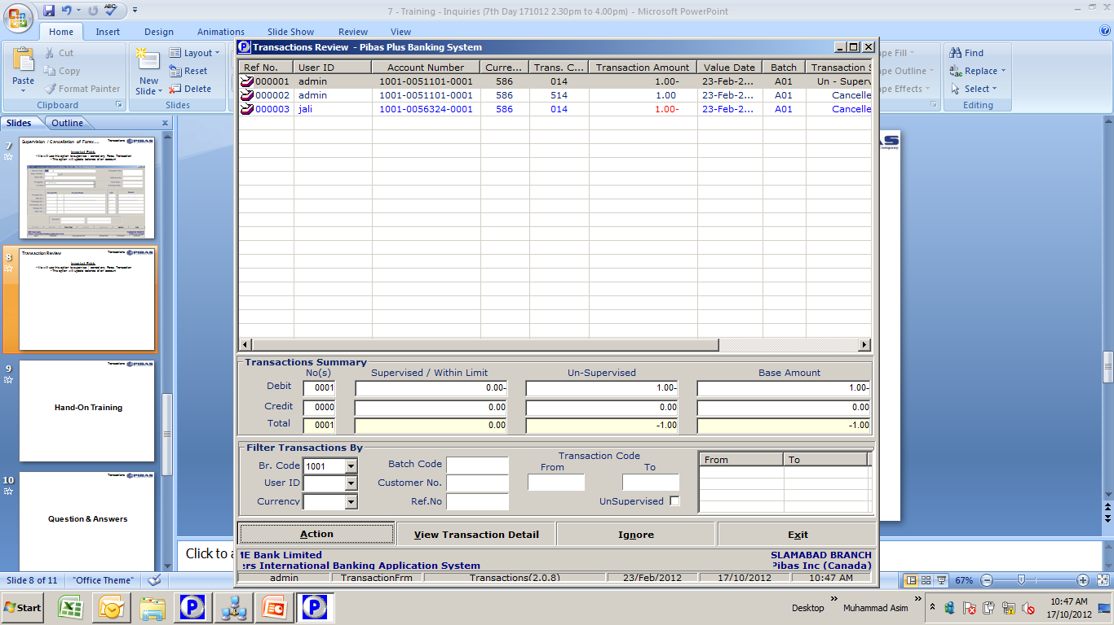
Transactions
Transaction Review
Important Points
We will use this option to review transaction during the day
Here several types of filter options available

Slide 9
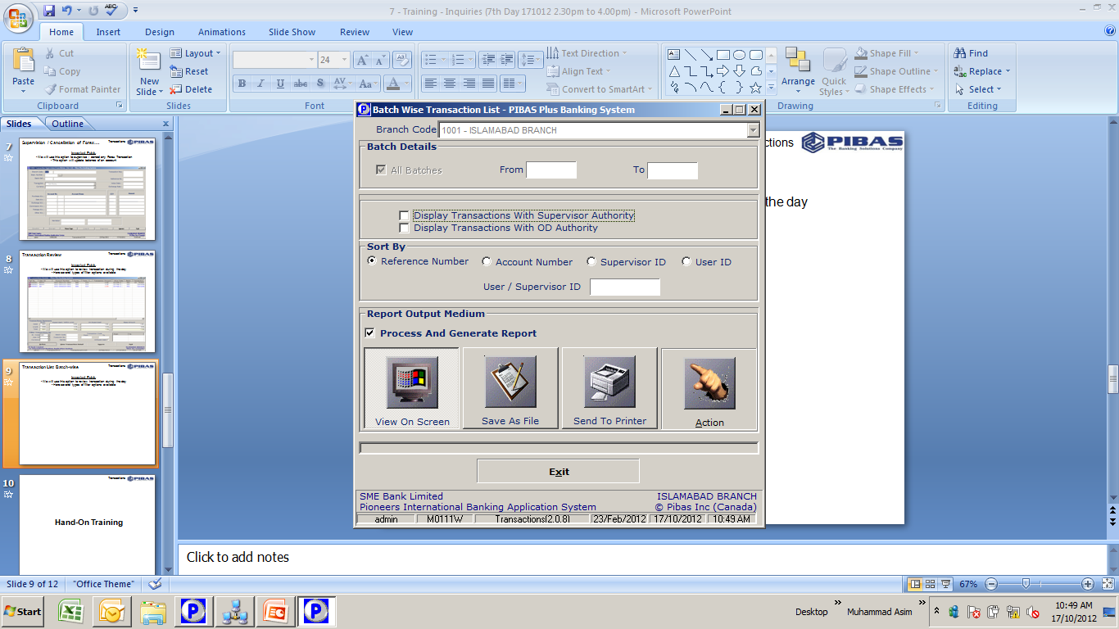
Transactions
Transaction List Batch-wise
Important Points
We will use this report to view / print list of transactions during a day

Slide 10
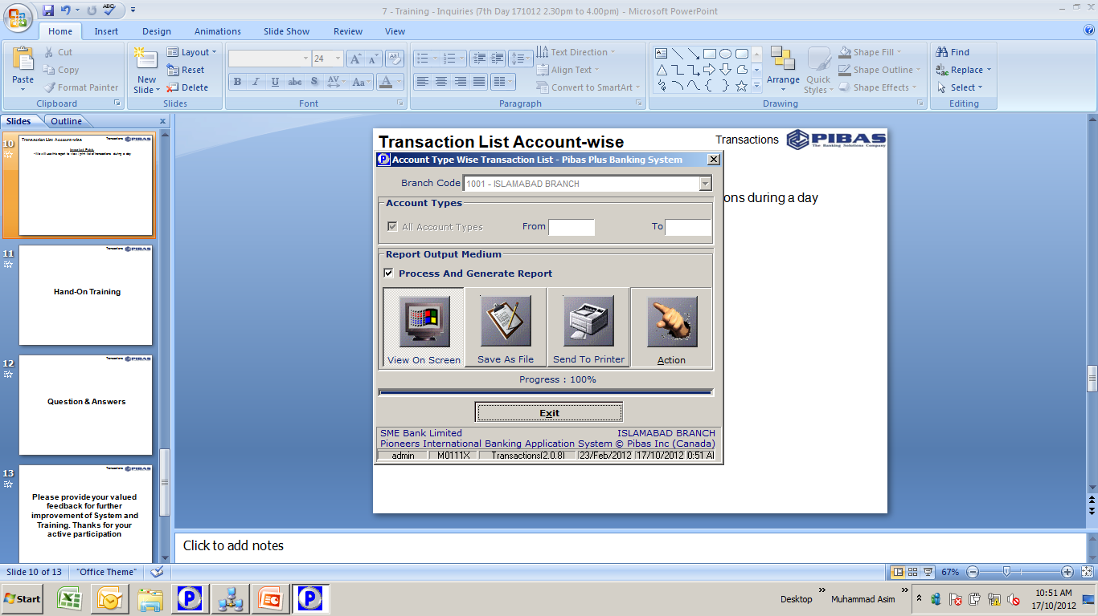
Transactions
Transaction List Account-wise
Important Points
We will use this report to view / print list of Account-wise Transactions during a day

Slide 11
Transactions
Many thanks for your active participation

